Slide 1
Multi Agent – Bug Triage System

Slide 2
Phase 1: Set Up Development Environment
Prerequisites (install before starting):
Python 3.10+ — core runtime for all agents and tools
Node.js — required for pptxgenjs and other JS tooling
Git — version control and GitHub integration
Visual Studio Code — code editor with Python extension
Python packages (pip install):
langgraph, langchain-openai, openai, chromadb, flask
pandas, openpyxl, requests, google-auth, googleapiclient, python-dotenv
Project setup:
Choose LangGraph as the agent orchestration framework
Create .env file with API keys; activate .venv virtual environment

Slide 3
Phase 2: Set Up External Services
GitHub — The Bug Database
Create a repository; add issues in the Issues tab (these are searched by the Detective agent)
Generate a Personal Access Token → set GITHUB_TOKEN and GITHUB_REPO in .env
Google Sheets — The Pattern Database
Enable Google Sheets API; create a service account; download credentials JSON
Set GOOGLE_SHEET_ID and GOOGLE_SHEETS_CREDENTIALS in .env; share sheet with service account email
ServiceNow — The Ticket System
Register for a free Personal Developer Instance at developer.servicenow.com
Set SERVICENOW_INSTANCE, SERVICENOW_USERNAME, SERVICENOW_PASSWORD in .env
Azure OpenAI — The Intelligence Layer
Set OPENAI_API_KEY, OPENAI_API_BASE, OPENAI_DEPLOYMENT, EMBEDDING_DEPLOYMENT, OPENAI_API_VERSION

Slide 4
Phase 3: Build Agent Tools
github_tool.py — GitHub Search Tool
search_github_issues(query, labels) — calls GitHub REST API /search/issues
Returns top 5 matching open issues with title, body snippet, labels, and URL
sheets_tool.py — Google Sheets Pattern Detection Tool
search_past_incidents(symptoms, days_back) — scans Sheet for keyword matches in last N days
Flags pattern_detected=True when 3 or more matching incidents found; triggers P1 escalation
log_incident(date, reporter, symptoms, resolution, ticket_id) — appends one row after ticket creation
servicenow_tool.py — ServiceNow Ticket Tool
create_incident() — POST to /api/now/table/incident; returns incident_number + incident_url
search_incidents() — checks for existing tickets before creating new ones
update_incident() — PATCH existing ticket with new work notes and escalated priority

Slide 5
Phase 4: Build the Multi-Agent System
state.py — BugTriageState (shared memory across all agents)
15-field TypedDict: user_message, priority, github_matches, incident_number, incident_url, action_taken, etc.
detective.py — Agent 1: GitHub Issue Search
Uses LLM to extract keywords from bug report → calls search_github_issues()
Sets github_matches, needs_user_clarification, selected_issue in state
brain.py — Agent 2: Priority Analysis + Pattern Detection
Calls search_past_incidents() on Google Sheets → feeds results to LLM for P1–P4 classification
Auto-escalates to P1 if 2+ unresolved similar incidents in past 7 days
fixer.py — Agent 3: Ticket Creation / Update + Triple Write-Back
Searches ServiceNow first; creates new or updates existing incident
After creation: logs to Google Sheets + adds to ChromaDB RAG + appends to Excel log

Slide 6
Phase 5: Add the RAG Layer
What is RAG in this system?
Retrieval-Augmented Generation: embed bug descriptions and search by semantic similarity
Two sources: GitHub issues + Excel past incident log — both indexed in ChromaDB
rag_store.py — The Vector Store Module
_embed(text) — calls Azure OpenAI text-embedding-ada-002 to generate vector
add_issue(id, text, metadata) — upserts embedding + metadata into ChromaDB collection “bug_issues”
search_similar(text, top_k=3) — cosine similarity query; returns hits with score = 1 - distance
RAG check node in workflow.py
Runs after Brain agent; if cosine distance < 0.3 → flags duplicate; skips ticket creation
After new ticket creation: fixer calls add_issue() so future bugs find it — self-improving knowledge base
excel_logger.py — Local Excel Log (also RAG source)
log_to_excel() appends: Incident Number, User Message, Priority, Incident URL to Past Incidents Log.xlsx

Slide 7
Phase 6: System Architecture
LangGraph Workflow (workflow.py) — 5-Node State Machine
Node 1: Detective → Node 2: Brain → Node 3: RAG Check → Node 4: Fixer → Node 5: format_response → END
Conditional Edges (3 branching paths):
Detective → format_response: if needs_user_clarification (multiple GitHub matches)
Brain → Detective (loop): if refined_search_needed with a new search query
RAG Check → format_response: if action_taken = duplicate_found (skip ticket creation)
Entry point — app.py (Flask)
POST /triage → in-memory MD5 dedup cache → triage_bug() in main.py → workflow.invoke()
Dual RAG sources for future lookups:
GitHub issues (searched by Detective) + Excel log (indexed in ChromaDB by Fixer) — both used for next query

Slide 8
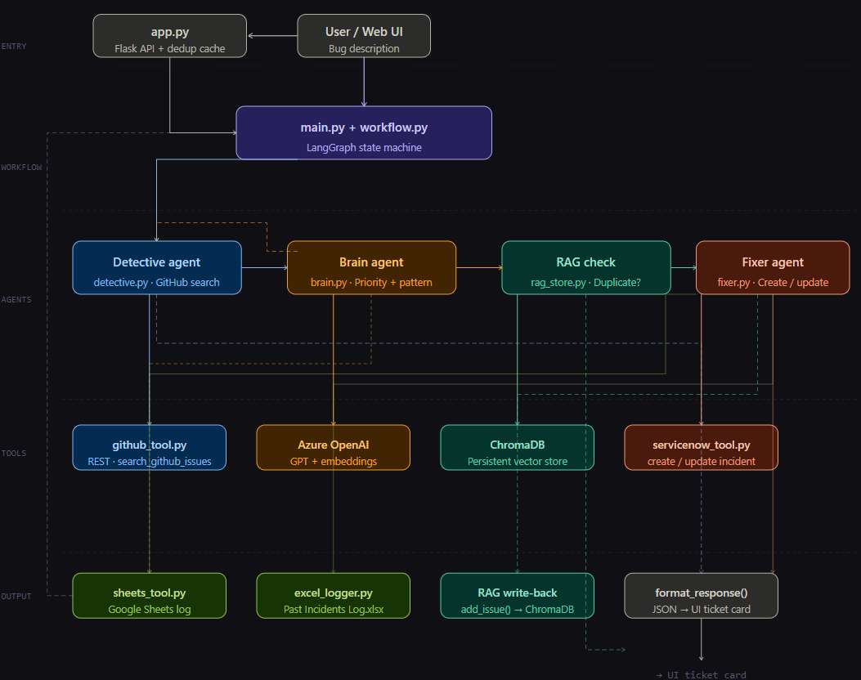

Slide 9
Workflow deep dive: Request Lifecycle
Step 1 — User submits bug via Web UI (app.py)
Flask chat interface; message POST to /triage; MD5 dedup cache checked first
Step 2 — Detective agent searches GitHub
LLM extracts technical keywords → GitHub REST search → if >1 match: asks user to clarify
Step 3 — Brain agent classifies priority + detects patterns
Reads Google Sheets for past 7 days → LLM assigns P1–P4 → may loop Detective for refined search
Step 4 — RAG check for semantic duplicates
Bug embedded → ChromaDB cosine query → if distance < 0.3: return existing ticket, no new creation
Step 5 — Fixer creates or updates ServiceNow ticket
New incident → triple write: Google Sheets log + ChromaDB upsert + Excel append (all try/caught)
Step 6 — Response formatted and returned to UI
JSON type: created | updated | duplicate | clarification | error → rendered as ticket card in chat UI

Slide 10
Summary
What this system achieves:
Fully auduplicate tickets: three-layer dedup — MD5 cache, ServiceNow search, ChromaDB RAG
Intelligent priority: LLM classifies P1–P4; auto-escalates to P1 on recurring patterns
Self-improving: every new incident is added to ChromaDB — future bugs find it via semantic search
Technology stack:
Orchestration: LangGraph (StateGraph with conditional edges)
AI: Azure OpenAI GPT (chat) + text-embedding-ada-002 (embeddings)
Vector DB: ChromaDB (persistent, cosine HNSW); Web: Flask; Storage: Google Sheets + Excel
Integrations: GitHub REST API, ServiceNow Table API, Google Sheets API v4
tomated bug-to-ticket pipeline: user describes issue → ticket created in ServiceNow in seconds
Zero

Slide 11
Key Design Decisions & Scalability
Three-Layer Duplicate Prevention
Layer 1: MD5 cache in app.py (same session, exact match)
Layer 2: ServiceNow text search (same short description, exact)
Layer 3: ChromaDB cosine similarity (semantically similar, cross-session)
Resilience & Fault Tolerance
Every tool call is wrapped in try/except — one failing write (Sheets/Excel/RAG) never blocks the ticket
LLM parse failures fall back to sensible defaults (P3 priority, keyword extraction)
Scalability Path
Replace _triage_cache dict with Redis for cross-restart persistence
Add Slack/Teams webhook support via existing /webhook endpoint
ChromaDB can be replaced with Pinecone or Weaviate for production vector storage

Slide 12
Thank you
Ritika Rani
A537510

